Slide 1
Instructor Presence
and First Impressions

Slide 2
What Do Your Students See First?
What does home page say about the class?
What does home page say about YOU?
Notes:
Ask them to pull up one of their Canvas classes and show it to the person next to them. What does that home page tell you about the class? The instructor?

Slide 3
Eliza Richardson, Penn State U
Slide from presentation by Alexa Maros & Lori Wamsley, PCC, at QM Works, 2015
Notes:
I attended the Quality Matters regional conference last April. This slide comes from a presentation by two faculty from Portland CC. They talked about how students felt more connected to their instructor because she told them she had a dog. The use of warm design helps students to feel more comfortable in the classroom. A tour of the classroom helps them feel more at home. What they see is what they think of you! The link goes to another home page by a geology professor at Penn State. Note how she has a photo of her in her office, with her Pez dispenser collection behind her. Also note the use of color in the design of home page.

Slide 4
Think about…
One unique, memorable thing about you.
One thing you’d like your students to know about you as a teacher.
Notes:
Now, I’d like you to think about two things. First, what’s one unique and memorable thing about you. Second, what’s the one thing you’d like your students to know right away about you as a teacher. Share this with your partner. Discuss how you can make these two things known on your home page (or in your video intro). Then, a few of us will share out with the group. I’m first….what have you learned about me from my presentation thus far? Any hints as to my interests???

Slide 5
What Do Students Want?
A connection to the instructor
Caring instructor
--Used live audio/video chats or lectures
--Posts frequently in chat rooms
--Invited student questions and responded quickly
--Provided detailed feedback on assignments
--Asked for and responded to student feedback about the course
--Clearly describe purpose of technology tools
Data from “Creating an Effective Online Instructor Presence,” Community College Research Center, Columbia University, 2013
Notes:
Imagine yourself as an online student. What do you want in your professor?

Slide 6
Real Student Feedback
Course name deleted

Slide 7
How Can We Make Better Connections?
http://bit.ly/1nBx95D
Notes:
Brainstorm with your table. Add ideas to the Google Doc. http://bit.ly/1nBx95D

Slide 8
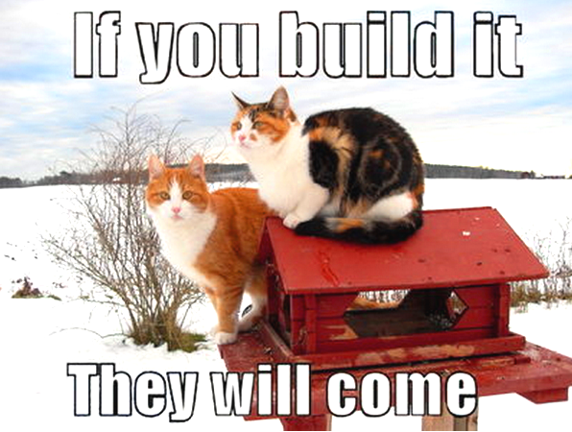
Office Hours
Notes:
One survey of 600 students found 2/3 had not attended office hours, and only 8% attended more than once a month.
Does this sound like your students? Are your numbers higher or lower?
Factors that made a difference to students

Slide 9
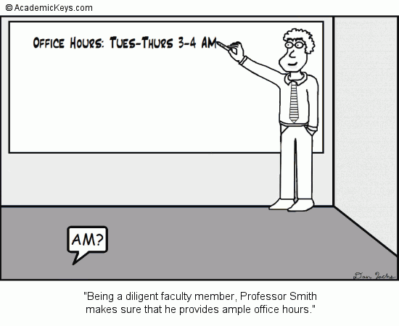

Slide 10
Office Hours
Factors That Influenced Whether Students Came to Office Hours:
Did they get useful feedback?
Was time/location convenient?
Course level, distribution vs. their major, large vs. small class
Were they already taking advantage of tutoring?
Fear/intimidation
http://bit.ly/1nBx95D
Notes:
One survey of 600 students found 2/3 had not attended office hours, and only 8% attended more than once a month.
Does this sound like your students? Are your numbers higher or lower?
Factors that made a difference to students
Factors that didn’t: email options, approachability, clear class expectations
What suggestions do you have for improving student attendance during office hours? Can be online or f2f…

Slide 11
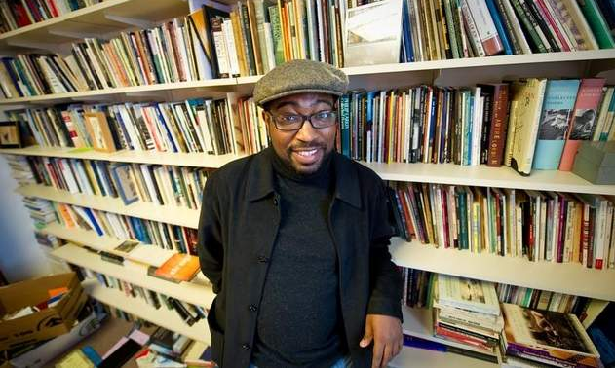
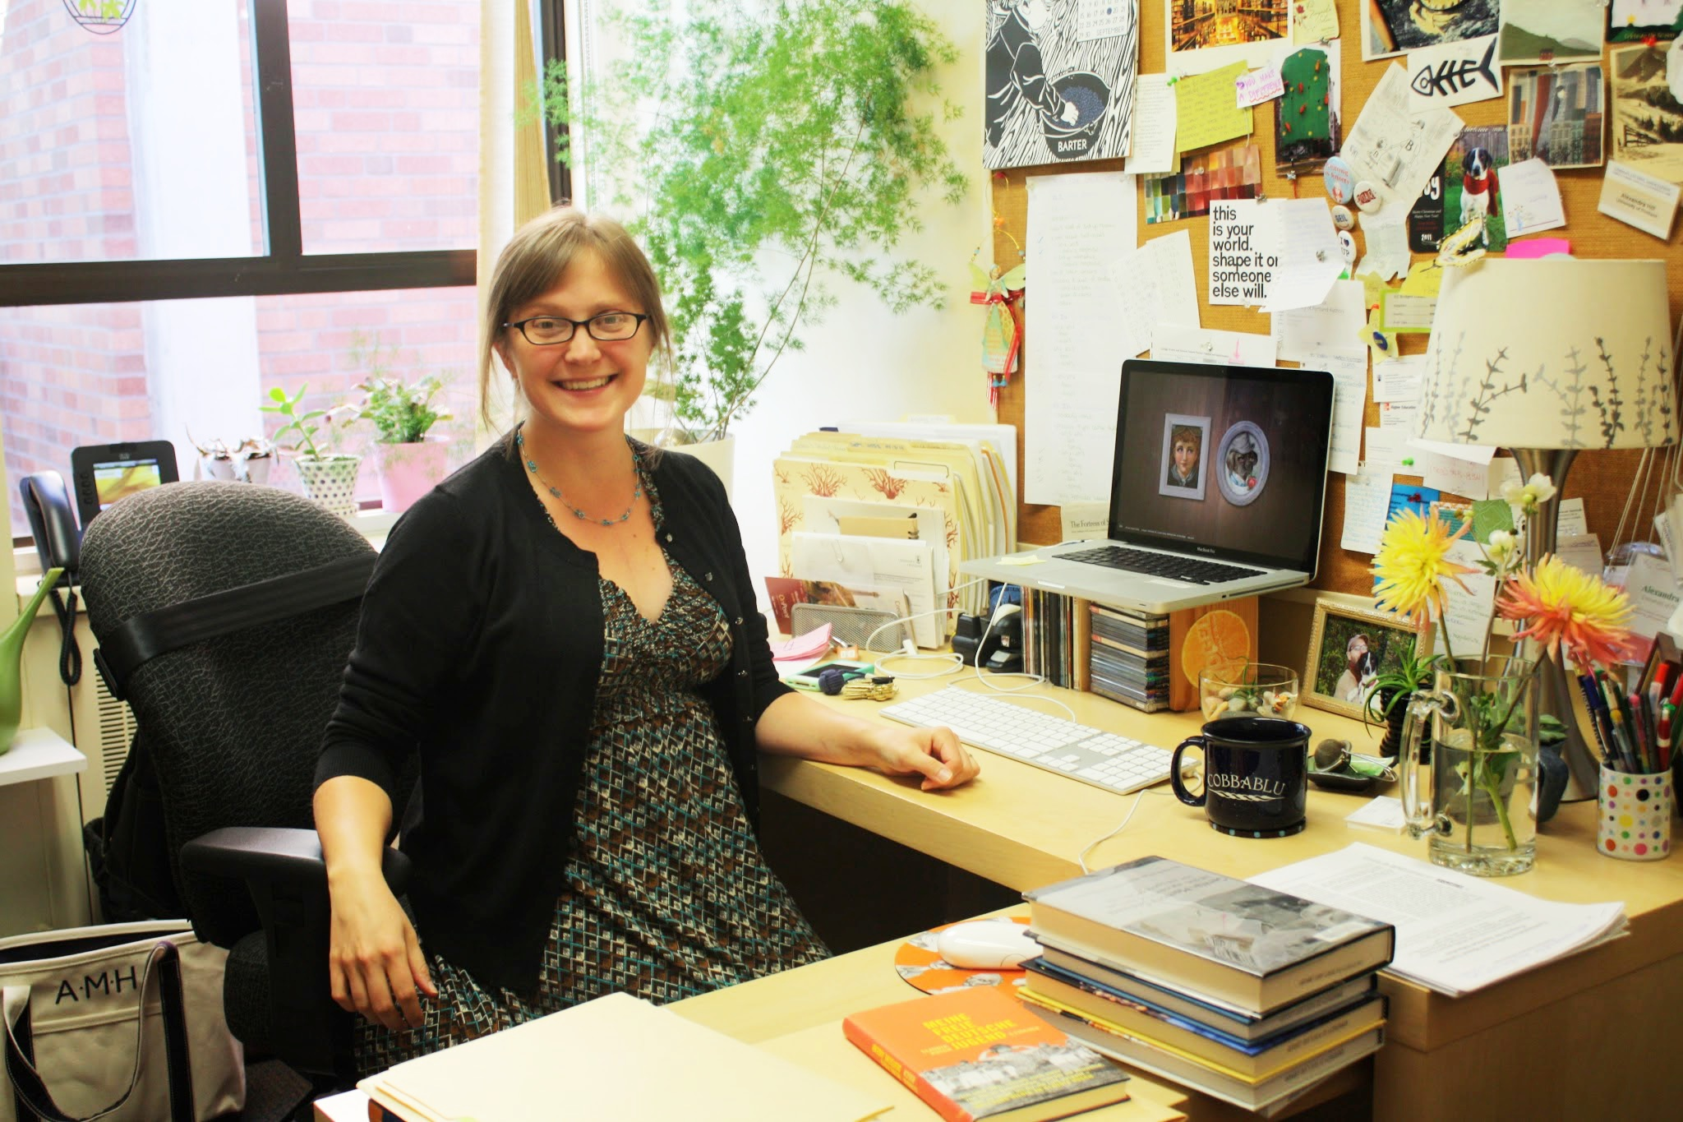
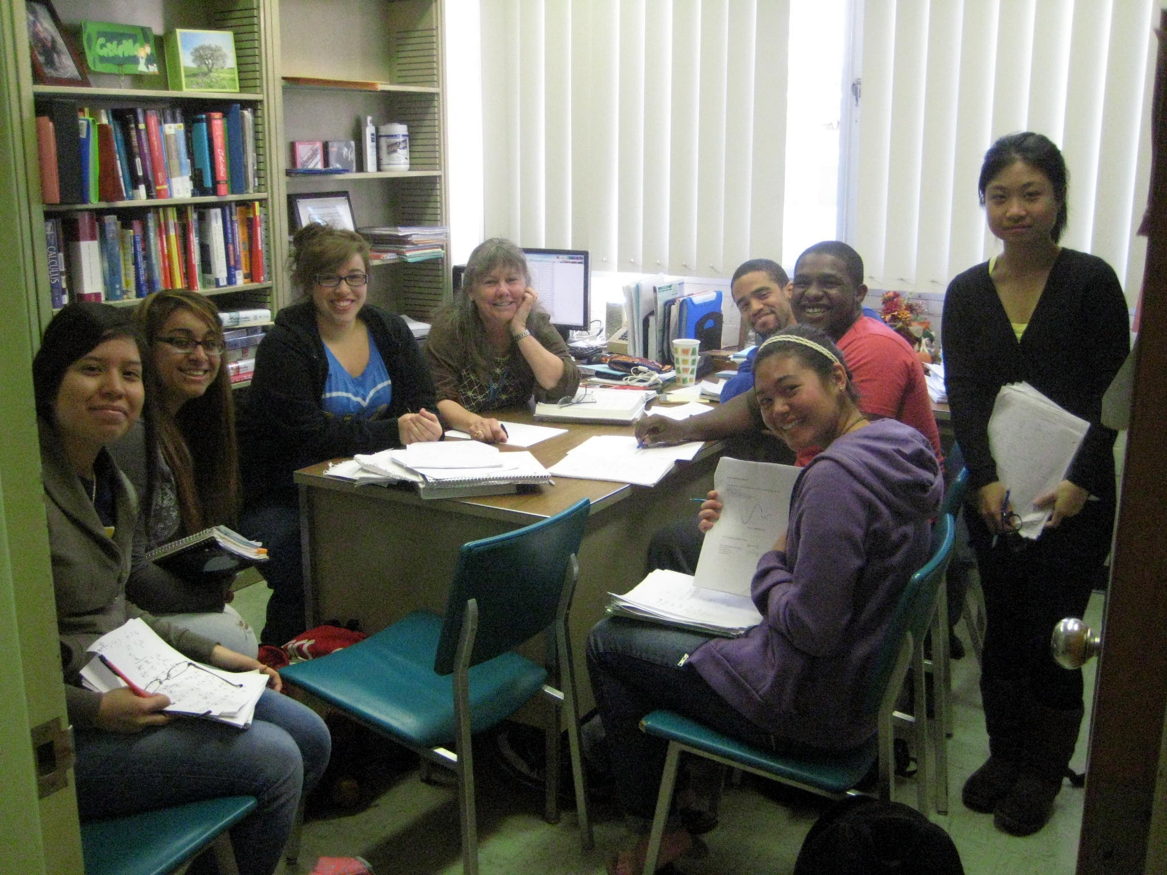
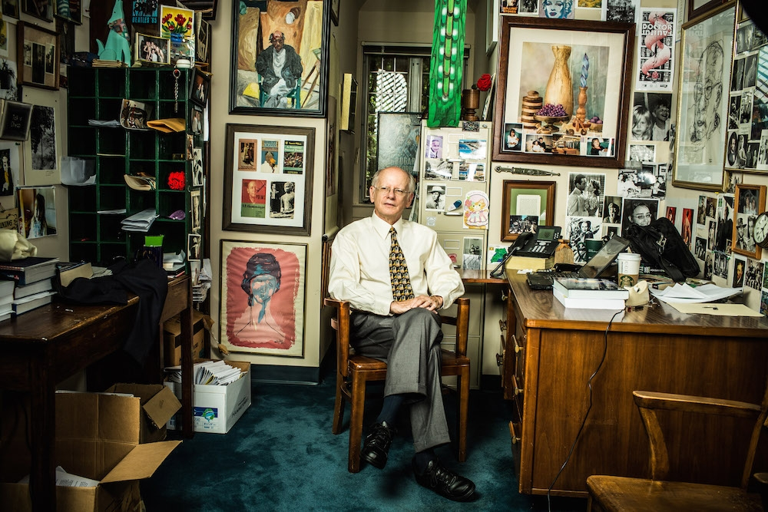
Notes:
Whose office makes you feel comfortable? Why? How could you improve each office?

Slide 13
I am worried about my grade….

